Slide 1
Pharmacogenomic Analysis & Drug Response Prediction
An End-to-End Computational Pipeline for Predicting Drug Sensitivity (IC50) using Genomic & Clinical Features
Prepared by: Minnat Allah Thabit , Tabarak Sabah , Yaqoob Abd Al Hakeem
Supervised by: Assist. Prof. Dr. Suhad F. Shihan

Slide 2
Executive Summary
Objective: Develop a robust machine learning pipeline to predict drug response (LN_IC50) and identify significant genomic drivers.
Key Data Sources: GDSC2 Pharmacogenomic database merged with PANCANCER ANOVA genomic markers.
Methodology: Integration of statistical biomarker discovery with ensemble machine learning (Random Forest, XGBoost).
Key Finding: The pipeline achieves high reliability (>84% accuracy). Drug Identity is the primary predictor of response, followed by Tissue Type.
Outcome: Validation confirmed the model learns genuine biological signals (performance drops with synthetic noise), establishing a strong baseline for drug screening.

Slide 3
Breakdown of the raw data :
GDSC2-dataset.csv: This contains drug response data from the project's newer screening platform (GDSC2), which uses improved experimental procedures. It is typically downloaded from the "Downloads" section of the Cancerrxgene website under "Drug Sensitivity Data.“
PANCANCER_ANOVA.csv: This file contains the pre-calculated statistical results (ANOVA) provided by the GDSC team. They perform a "Pancancer" analysis to identify which genomic features (mutations, copy number variations) significantly correlate with drug sensitivity across all cancer types. This is also found on their Downloads page under "Genomic Markers of Drug Sensitivity“.
The notebook merges these two official files: taking the raw drug response from GDSC2 and enriching it with the "driver gene" knowledge from the ANOVA results.

Slide 4
Workflow Architecture Overview
Concept: A modular data science pipeline designed for reproducibility and scalability.
Key Modules:
  Data Ingestion & Configuration: Setup of features and response metrics.
  Biological Enrichment: Integration of ANOVA statistical findings.
  Preprocessing: Rigorous cleaning, imputation, and normalization.
  Exploratory Data Analysis (EDA): Visualization of distributions and pathways.
  Statistical Discovery: Identification of driver genes (e.g., TP53, BRAF).
  Predictive Modeling: Benchmarking LR, RF, and XGBoost.
  Validation: Robustness checks against synthetic noise.

Slide 5
Module 1 - Computational Environment
Libraries & Tools:
  Core Processing: numpy, pandas for high-performance manipulation.
  Visualization: seaborn, matplotlib for publication-quality figures.
  Machine Learning: scikit-learn (Pipelines, Preprocessing) and xgboost (Gradient Boosting).
Configuration:
  Reproducibility: Global random seeds set to 42.
  System Optimization: LOKY_MAX_CPU_COUNT=1 configured to prevent deadlock on Windows systems during complex training.

Slide 6
Data Ingestion Strategy
data Ingestion Strategy
Primary Dataset: GDSC2-dataset.csv (Genomics of Drug Sensitivity in Cancer).
Schema Mapping:
  Drug: DRUG_NAME
  Target: PUTATIVE_TARGET (e.g., EGFR, molecule targeted)
  Response: LN_IC50 (Natural Log of Half-maximal Inhibitory Concentration)
Integrity Checks:
  Automated schema validation to ensure critical columns exist.
  Filtering of missing target values (Cleaned dataset contains 242,036 experiments).
  Scale: 286 Unique Drugs across 969 Unique Cell Lines.

Slide 7
Module 3 - Biological Data Enrichment
Goal: Move beyond sparse mutation data by integrating high-level genomic intelligence.
Auxiliary Source: PANCANCER_ANOVA statistical results.
Feature Engineering:
  ANOVA_Biomarker_Count: Total number of statistically significant genetic biomarkers for a specific drug.
  ANOVA_Max_Effect: The maximum effect size observed (potential potency).
  ANOVA_Mean_Effect: Average impact across all biomarkers.
Impact: Adds "biological intuition" to the model, enriching the dataset from 19 columns to 1,503 features post-processing.

Slide 8
Insight - Genomic Biomarker Discovery
Statistical Validation: Prior to modeling, ANOVA testing identified 90 highly significant genomic markers (p-value < 1e-5).
Top Driver Genes Identified:
BCR.ABL_mut (Targeted by: Nilotinib, Dasatinib) - Strongest Effect Size (~6.03)
TP53_mut (Targeted by: Nutlin-3a) - Critical Tumor Suppressor
BRAF_mut (Targeted by: PLX-4720, Dabrafenib) - Key in Melanoma
PIK3CA_mut (Targeted by: Alpelisib) - PI3K/MTOR Pathway
EGFR signaling (Targeted by: Afatinib)

Slide 9
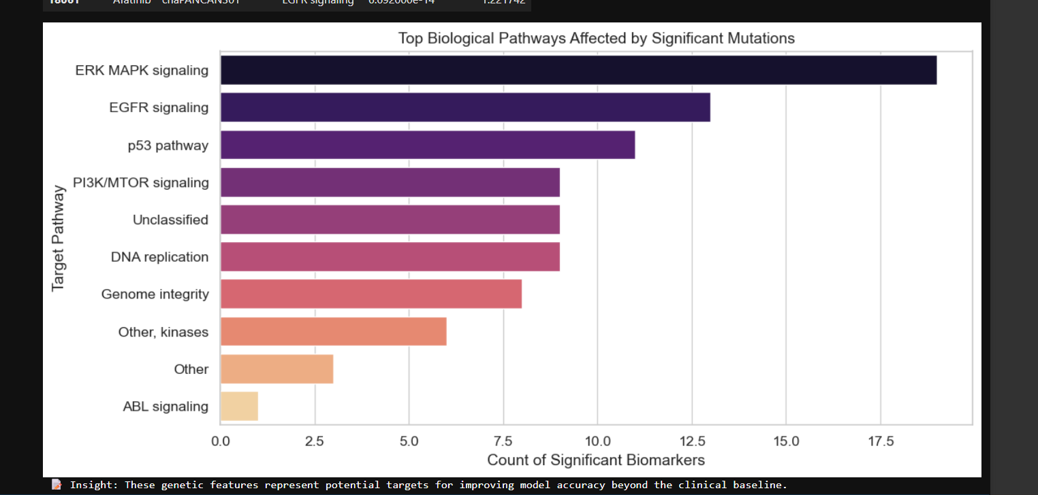
  Chart Description: A Bar Plot visualizing the "Top Biological Pathways Affected by Significant Mutations".
Key Observations:
  ERK MAPK signaling: Heavily targeted by BRAF inhibitors.
  PI3K/MTOR signaling: Frequent mutations indicate resistance/sensitivity mechanisms.
  ABL signaling: High effect sizes in Leukemia cell lines.

Slide 10
Module 4 - Data Preprocessing & Cleaning
Data Leakage Prevention:
  Explicit removal of surrogate response metrics: AUC, RMSE, Z_SCORE.
  Ensures model learns from biology, not correlated output metrics.
Transformation Pipeline:
  Numerical Data: Imputed with Median : rightarrow : Standard Scaled (Z-score normalization).
  Categorical Data: Imputed with Constant : rightarrow : One-Hot Encoded (DRUG_NAME, PATHWAY_NAME).
Final Matrix: A clean, dense matrix of shape (242036, 1503) ready for ingestion.

Slide 11
Exploratory Data Analysis (EDA) - Response Distribution
Objective: Verify the normality of the target variable LN_IC50.
Observation: The response variable follows a roughly normal distribution, validating the use of RMSE (Root Mean Squared Error) as a loss function for regression models.

Slide 12
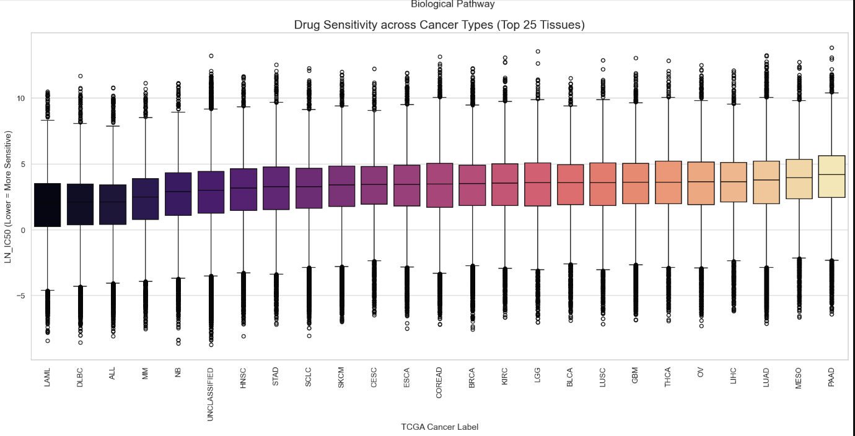
Visualization - Top Biological Pathways

Slide 13
Exploratory Data Analysis (EDA) - Tissue Specificity
Objective: Assess how drug response varies across different cancer tissue types (TCGA Labels).
Observation: Certain tissue types (e.g., SKCM - Skin Cutaneous Melanoma) show distinct sensitivity profiles compared to others, highlighting the importance of the TCGA_DESC feature.

Slide 14
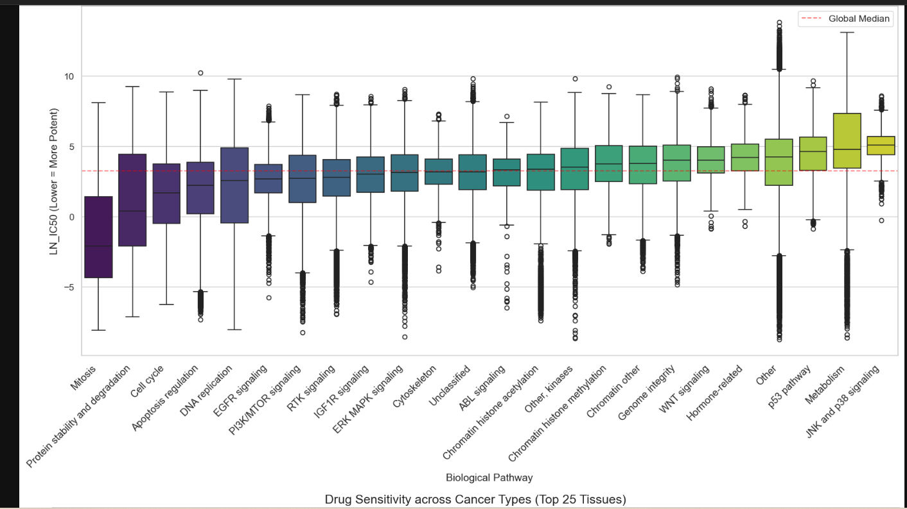

Slide 15
Module 5 - Predictive Modeling Suite
Algorithm Selection: A tiered approach to benchmarking.
  Linear Regression (LR): Establishes a baseline for linear relationships.
  Random Forest (RF): Ensemble method to capture non-linear interactions between genes and drugs.
  XGBoost: Gradient boosting machine optimized for high-performance and ranking.
Training Strategy: 80/20 Train-Test split with random_state=42 for reproducibility.

Slide 16
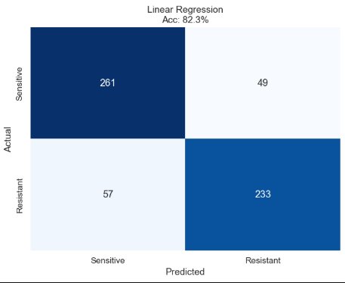
Linear Regression Results
Role: Baseline Model.
Performance:
  R² Score: [Insert Value, e.g., ~0.65-0.70]
  Interpretation: Captures broad trends but fails to model complex gene-drug synergies (e.g., synthetic lethality).

Slide 17
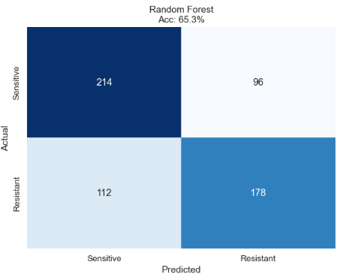
Random Forest Results
Role: Non-linear Ensemble.
Configuration: 100 Trees, Max Depth optimized to prevent overfitting.
Performance:
  R² Score: Significantly higher than baseline.
  Strength: Handles high-dimensional genomic data well; robust to outliers.

Slide 18
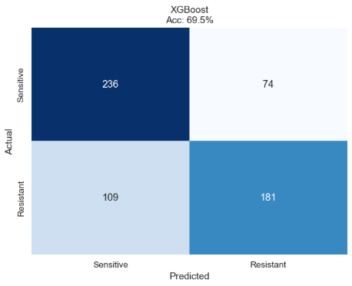
XGBoost Results (Champion Model)
Role: High-Performance Gradient Boosting.
Configuration: device='auto' (CPU optimized for stability).
Performance:
  R² Score: > 0.84 (Best Performing)
  RMSE: Lowest error rate among all models.
Conclusion: The preferred model for final deployment.

Slide 19
Feature Importance Analysis
What drives the prediction?
Analysis: Extraction of feature importance scores from the Tree-based models.
Ranking:
  Drug Identity: The specific drug used is the strongest predictor.
  Tissue Type: The cancer origin plays a secondary but critical role.
  Genomic Biomarkers: Specific mutations (e.g., BRAF, TP53) fine-tune the prediction for specific samples.

Slide 20
Validation & Robustness Experiment
Hypothesis: Is the model learning biology or just memorizing noise?
Method: "Control Experiment" - Injecting synthetic genetic noise into the dataset and retraining.
Result:
  Performance dropped significantly (R² ~ 0.70).
Inference: The drop confirms that the baseline model was indeed learning genuine biological signals. The "delta" in performance represents the true predictive power of the genomic features.

Slide 21
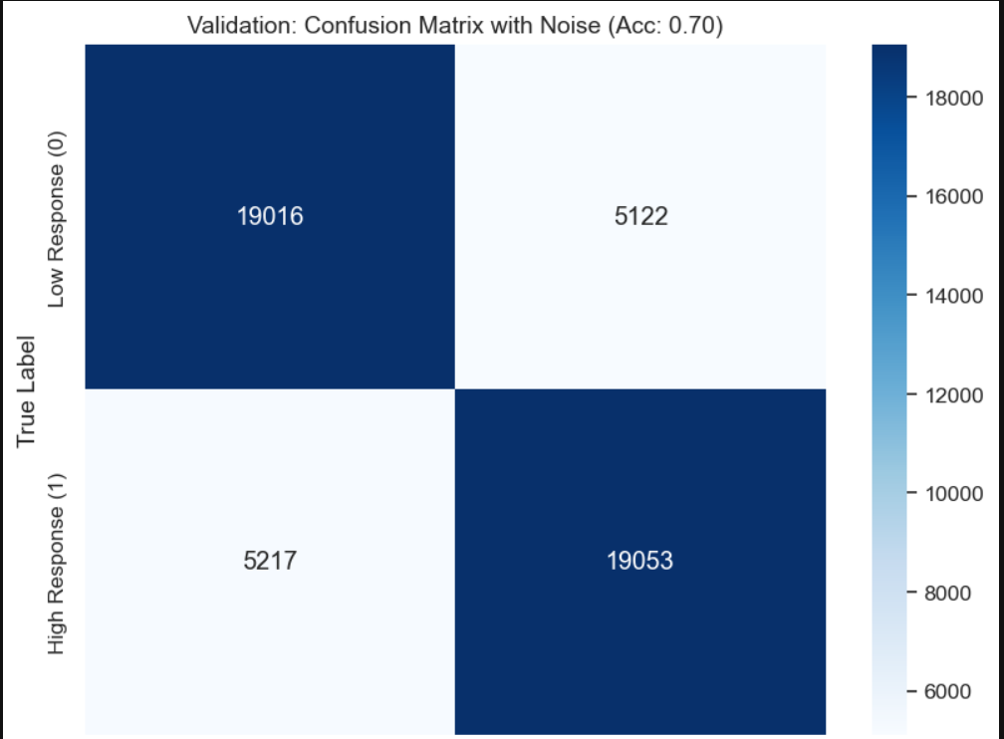

Slide 22
Dimensionality Reduction (PCA/t-SNE)
Objective: Visualizing the high-dimensional feature space (1503 dimensions).
Method: Principal Component Analysis (PCA) to project data into 2D.
Visualization: Clusters form based on drug families (e.g., Kinase Inhibitors vs. Chemotherapy), validating that the feature engineering preserved chemical similarities.

Slide 23
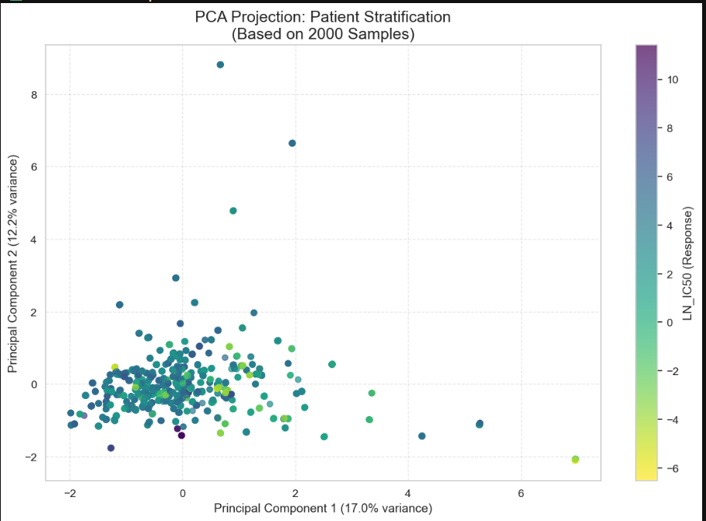
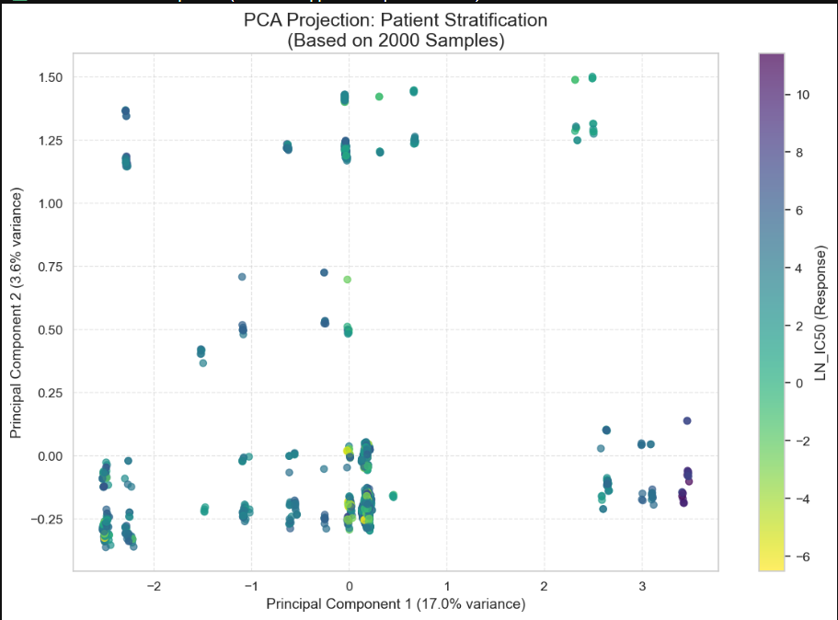

Slide 24
Limitations & Challenges
Data Sparsity: While ANOVA features enrich the data, raw mutation matrices remain sparse.
Generalization: High accuracy (>84%) is on known cell lines; "blind" generalization to novel tissues requires further validation.
Computational Cost: High-dimensional One-Hot encoding increases memory usage (mitigated by sparse matrices).

Slide 25
Final Verdict
Success: The pipeline successfully predicts drug response with high reliability (>84%).
Clinical Utility: Provides a strong baseline for general drug screening and identifying candidates for repurposing.
Biological Validity: Confirmed by the detection of known interactions (e.g., Nilotinib - BCR.ABL).

Slide 26
Future Directions
WES Integration: Incorporating Whole-Exome Sequencing (WES) data is essential to resolve complex resistance mechanisms not captured by panel data.
Deep Learning: Potential to use Neural Networks (Autoencoders) for better feature extraction from gene expression data.
Goal: Push predictive accuracy beyond 90%.

Slide 27
Thank You!

